Slide 1
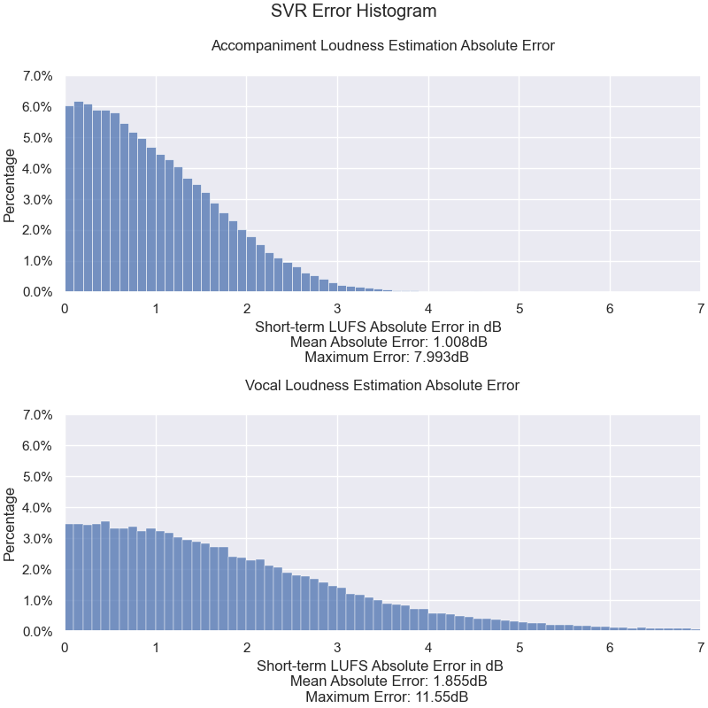
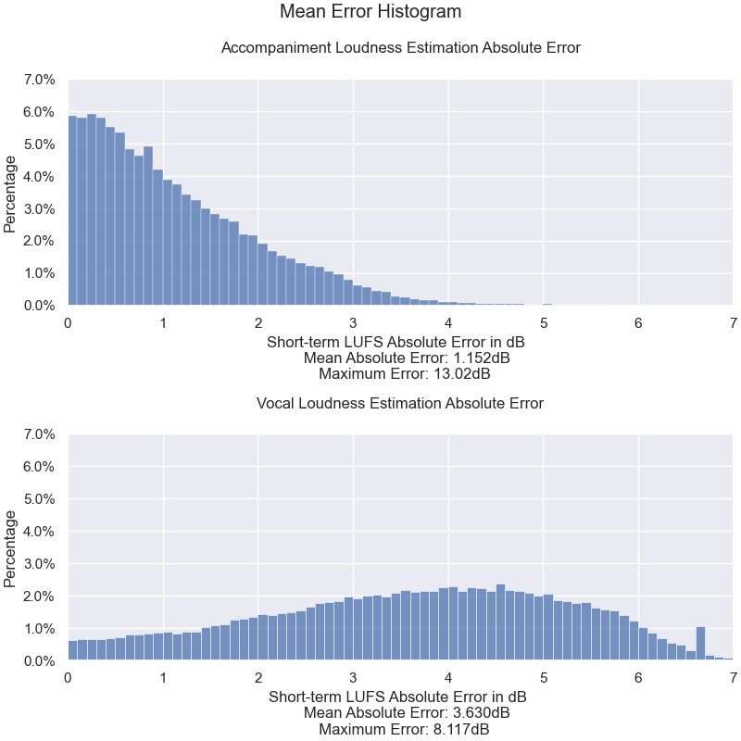
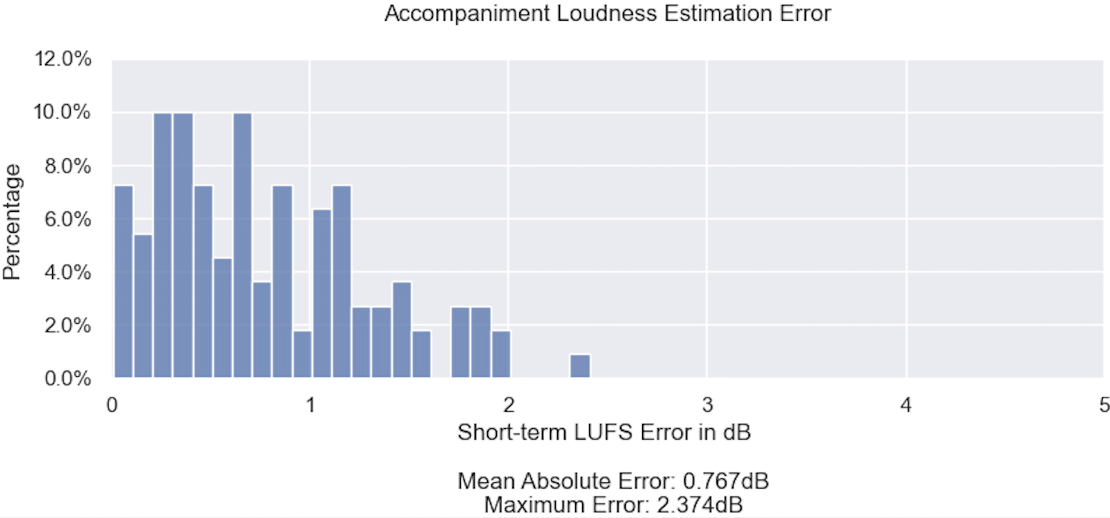
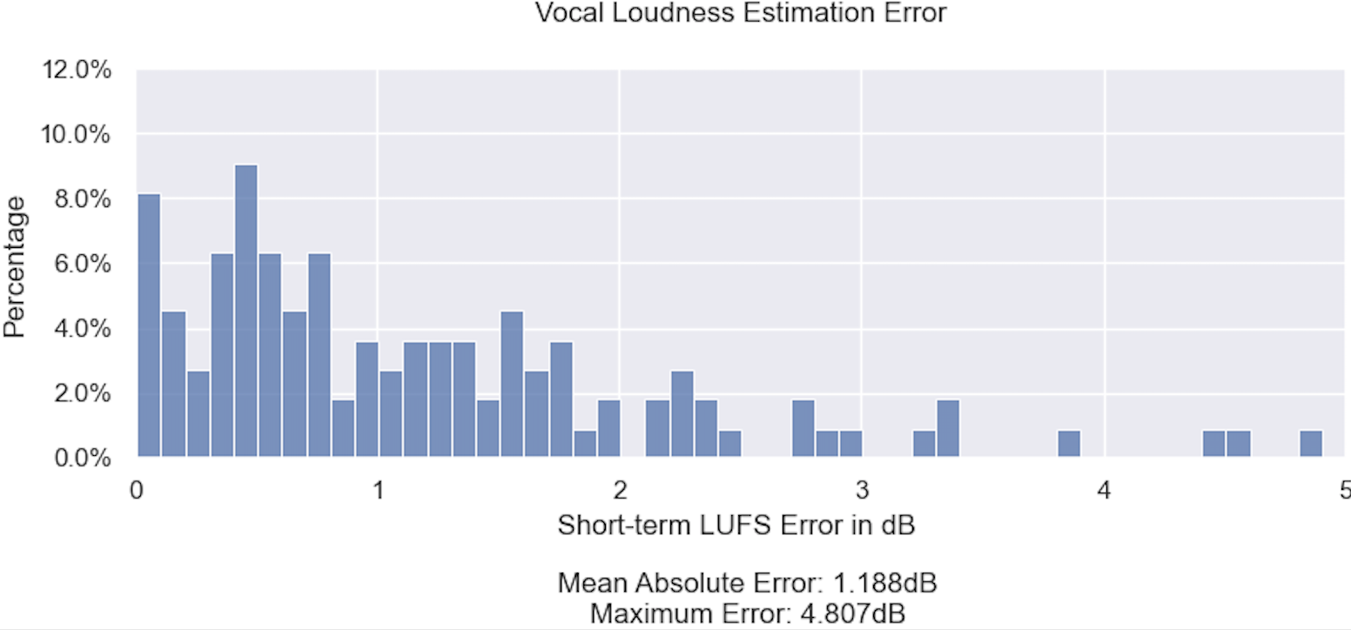
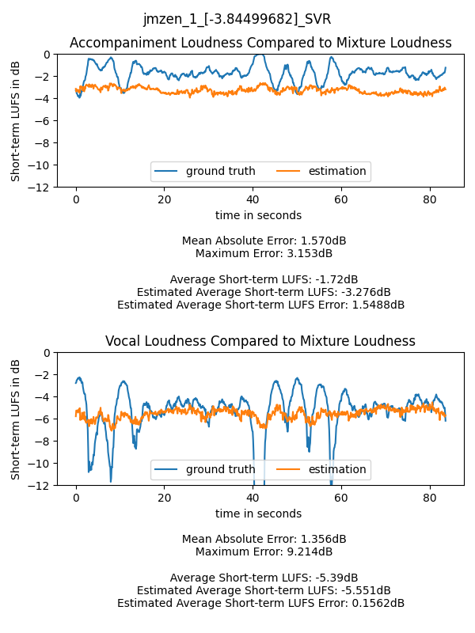
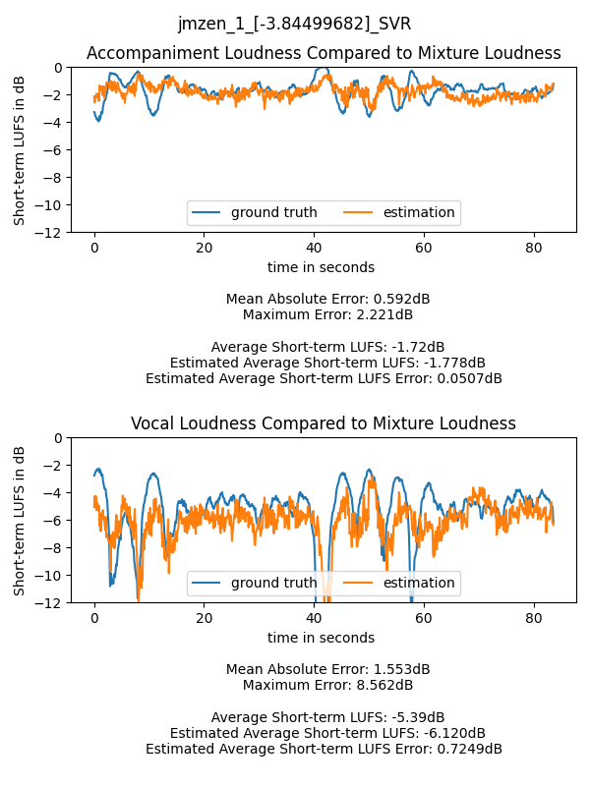
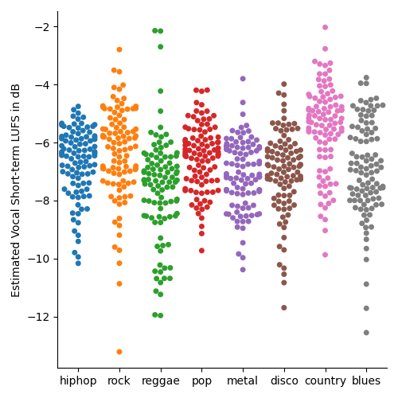
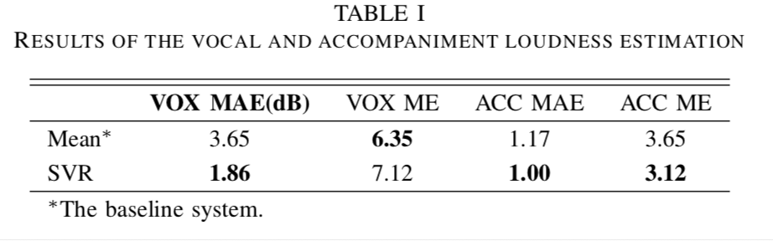
Kelian (Mike) Li
Music Informatics Lab
Center for Music Technology
kli421@gatech.edu
Mixture Vocal Loudness Estimation and Genre Analysis
Introduction
Error Histogram
With the isolated vocal and accompaniment tracks available for training, we can use machine learning to estimate the vocal loudness from the mixture signal.
The ground truth is the short-term loudness of isolated vocal loudness. The audio signals are sliced into overlapped segments of 3 seconds length with the hop size of 100 ms following the EBU recommendation
The input features to the SVR model are the first 20 Mel-Frequency Cepstrum Coefficients (MFCC), 128 VGGish embeddings, and the short-term loudness of the mixture signal.
Because the mixture loudness can be measured directly from the audio signal, estimating the relative vocal loudness (vocal-to-mixture ratio) is equivalent to estimating the absolute vocal loudness. The target vocal loudness values are transformed from the absolute short-term loudness to the loudness difference compared with the mixture loudness,
where STL∆vox is the relative vocal loudness, STLvox is the short-term loudness of the vocal signal, and STLmixture is the short-term loudness of the mixture signal.
Estimation
Genre Analysis
The left figure uses epsilon of 0.3, and the right figure uses epsilon of 0.1.
Epsilon = 0.3 yields lower MAE, but unable to predict the loudness outside of a small range.
Results
Genre | hiphop | rock | reggae | pop | metal | disco | country | blues
Relative Vocal Loudness (dB) | -6.69 | -6.36 | -7.58 | -6.52 | -7.13 | -7.02 | -5.51 | -6.90
CONTACT
Kelian (Mike) Li
Music Informatics Lab
Center for Music Technology
kli421@gatech.edu

